Slide 1


King County Houses
By: Jennyfer Vu

Slide 2
Problem Statement
How do buyers know what the asking price of a house consists of? Number of bedrooms? View? Location?
We will be diving into different factors that all contribute to the price of a home
The client for this project will be potential home buyers in King County, WA

Slide 3
Data Wrangling
First we need to wrangle/clean the data:
Missing values—NaN replaced with the mean
Outliers—e.g. 33 bedroom house removed
Objective—What can we ask of the data? What story can the data provide us?

Slide 4
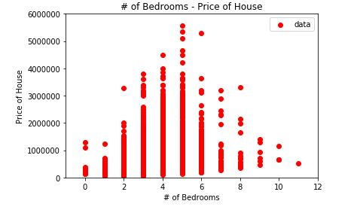
Exploratory Data Analysis
After cleaning the data, we take a look at the relationship between variables
First, let’s explore how number of bedrooms will affect the price of a property.

Slide 5
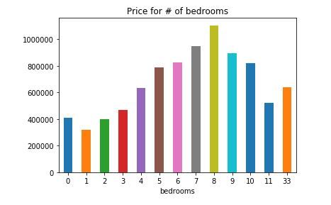
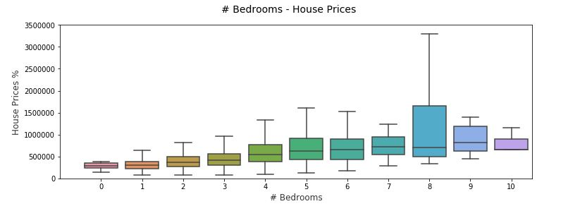
Bar chart showing house price vs. # of bedrooms
Box plot showing house price vs. # of bedrooms

Slide 6
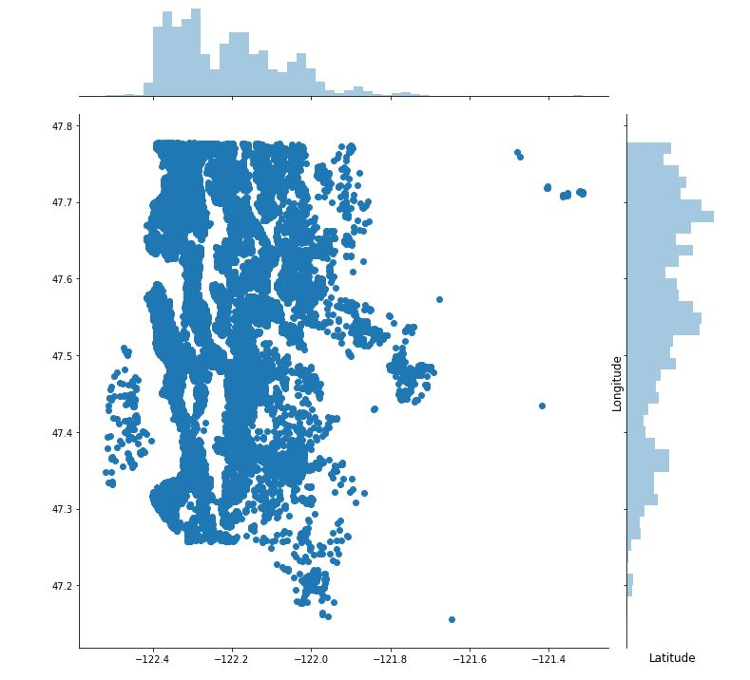
Next, we will plot properties by latitude and longitude in King County.
The highest concentration of homes are between latitude -122.4 and -122 and longitude 47.25 and 47.8
The coordinates for Seattle, WA are 47.6062° N, 122.3321° W

Slide 7
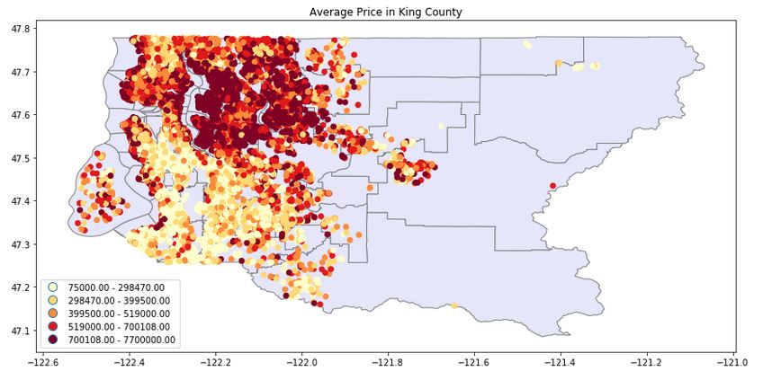
The figure above shows the average listing price by latitude/longitude. As you can see, the closer the house is to metropolitan Seattle, the higher the average listing price.

Slide 8
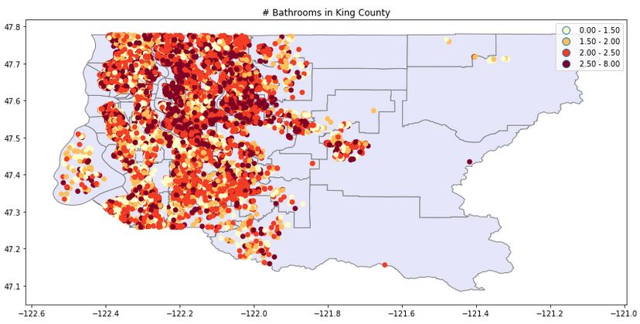
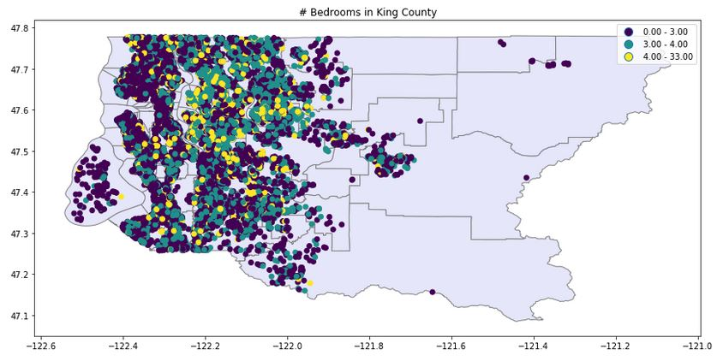
The two figures above show number of bedrooms and bathrooms. This is to show that there is not a strong correlation between these two variables and the area that they are located. This is important for homebuyers to know that these variables are not location dependent.

Slide 9
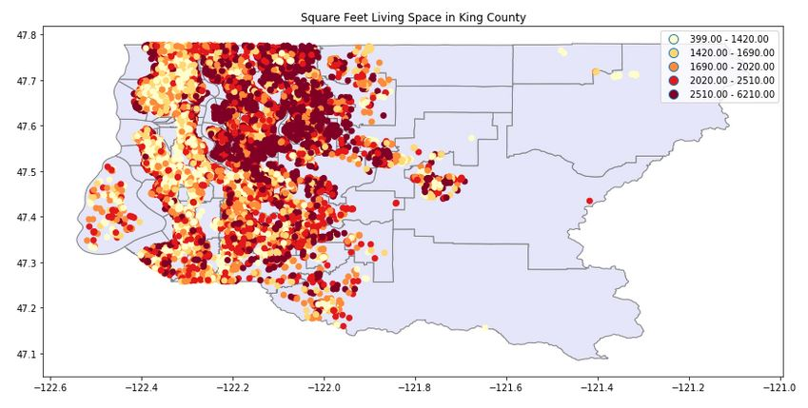
This figure shows square feet living space in King County. It appears that there are smaller properties closer to the waterfront. This is explained by there not being as much space and square footage for large properties closer to the water. Houses get larger in square footage further west.

Slide 10
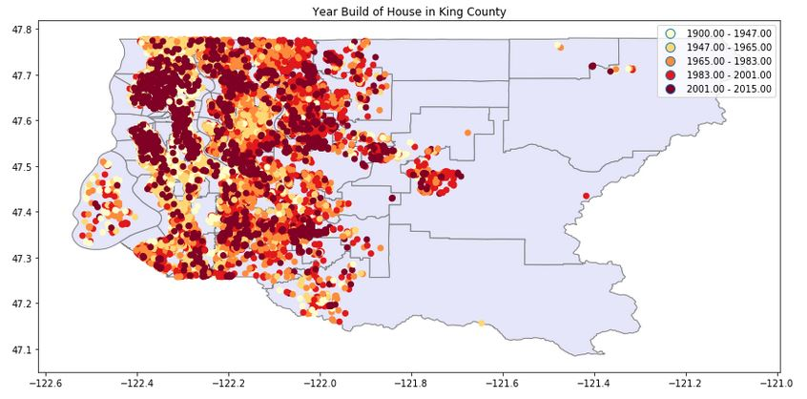
This figure shows that year build of houses in King County is extremely varied. It appears that older properties (white-yellow, 1900-1965) are located towards the waterfront which may be explained by early settlers building there first. There is tremendous new construction over these older areas and all over King County.

Slide 11
Inferential Statistics
After exploratory visual data analysis, we will take a look at what the statistics of the data mean.
Variables such as price of the house, number of bedrooms, bathrooms, square footage, location (zipcode) of a property.
All of these factor into the purchase price of a home.

Slide 12
One-Way ANOVA
We will be conducting the One-Way ANOVA to compare if the mean price of multiple zipcodes are equal.
Null hypothesis: The mean price between different zipcodes are the same.
Alternative hypothesis: The mean price between different zipcodes are different.

Slide 13
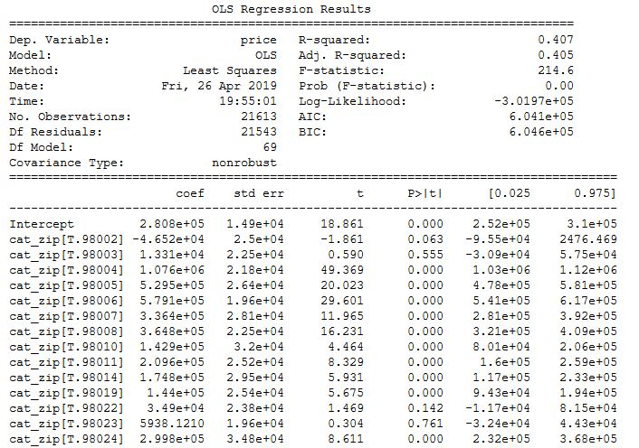

Slide 14
Looking at the p-value under P>|t| we can see that most zipcodes are so small that they are close to 0.000
This means that they are statistically significant and the means do differ and are unequal. This can be interpreted as the zipcode is a statistically significant predictor of price.
This means that the difference is not statistically significant and we can't reject the hypothesis that their means are equal.
The computed F-statistic is 214.6 Typically a high F-value means that your data does not support the null hypothesis well. This means that we reject the null hypothesis and that there is statistical significance between price of a property and location.

Slide 15
In-Depth Machine Learning Analysis
Supervised Learning:
Since this project is looking at how labeled data such as bedrooms, square footage, and area affect price of a house, this is considered supervised learning (labeled or categorized).
Linear Regression:
In general, the closer the coefficient R^2 is to 1.0, the better the model fits the data. Our aim will be to get as close to 1.0 as possible. In the model above, we are returned a score of R^2 = 70.7%

Slide 16
In-Depth Machine Learning Analysis
Gradient Boosting:
Gradient boosting regression is a machine learning model that is constructed from an ensemble of weak prediction models such as decision trees. Gradient boosting increased model’s score to 91.98%!
Random Forest:
Random forest is a more complex model that was able to lower the RMSE from 200,914 to 139,025 dollars. Random forest builds multiple decision trees and merges them together to get a more accurate and stable prediction.

Slide 17
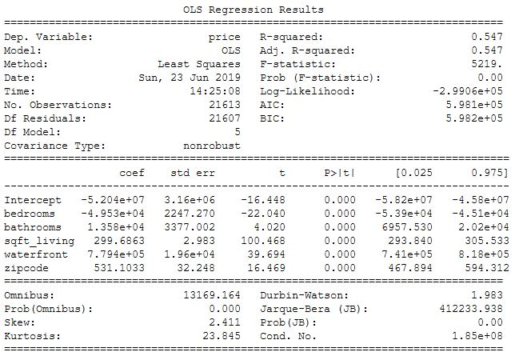
In-Depth Machine Learning Analysis
Fitting Linear Regression using statsmodels:
Looking at the coefficients in the middle table, let us first interpret the bathroom coefficient (1.358e+04) by looking at the p-value which is so small, essentially zero.
This means that number of bathrooms is statistically significant as a predicter of price.
Negative correlation means negative relationship b/w variables (inverse relationship)

Slide 18
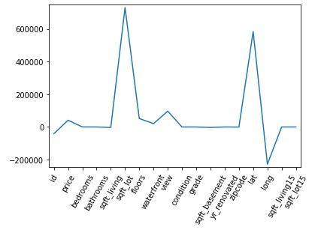
In-Depth Machine Learning Analysis
Lasso Regression:
Lasso is used to select the most important features in prediction, in this case prediction of house prices.
Lasso regression above illustrates that square footage for living/lot size, waterfront view, zipcode, and lat/long are the most important features selected by lasso regression coefficients for predicting price.

Slide 19
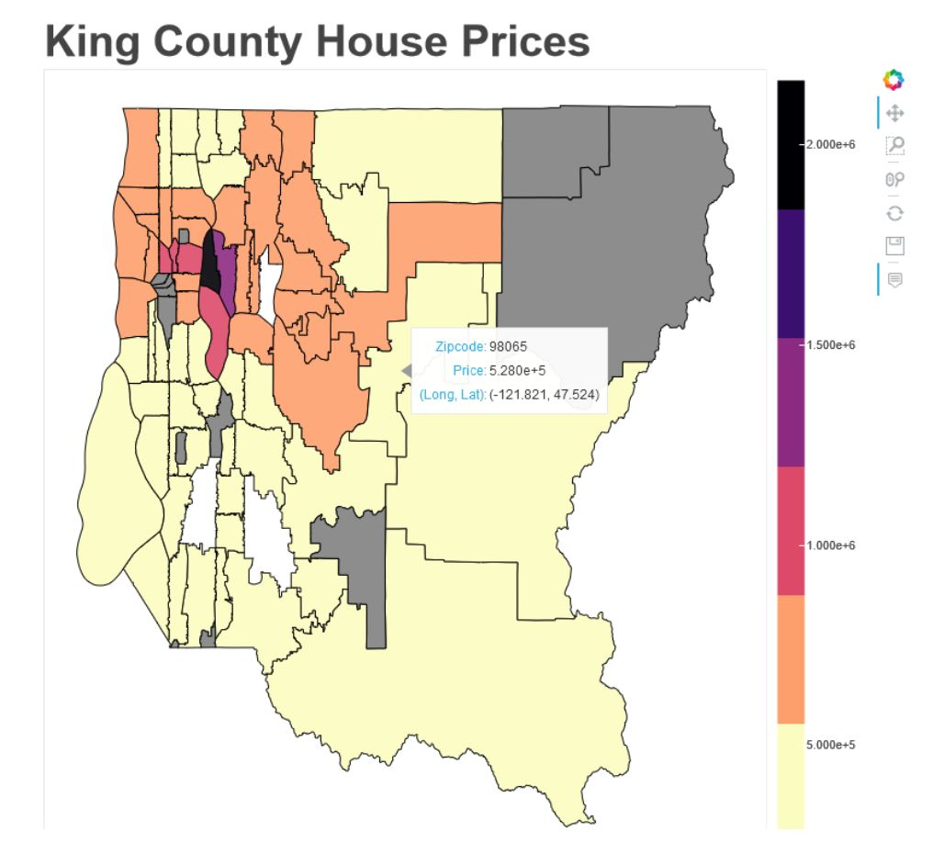
Bokeh
In addition to EDA, statistics, and machine learning there is a very important tactic to convey your data to an audience.
Through python, we decided to convey the data visually by using Bokeh which is an impressive library that can handle large datasets.
As we can see, Bokeh is able to allow users to interact and display different values depending on what variable they are interested in.

Slide 20
Conclusion
It is possible to use machine learning to predict property prices in King County.
These methods are not perfect but they do allow for homebuyers to be more informed and equipped with knowledge when buying a house.
Location, condition/grade, waterfront view, and number of bathrooms were all important features of influence on the price of a property.

